Slide 1

DATABASE OF A FOOTBALL LEAGUE

Slide 2
Aim of the Project :
To design and implement a comprehensive database application for managing data of a football league.

Slide 3
Our Approach
Understanding the Problem Statement
Planning and Designing
Implementation

Slide 4
Understanding the problem statement
In this stage, we obtain relevant knowledge of the concerned domain and enlist all data requirements to ensure that we collect all the necessary information and represent it in the appropriate manner.

Slide 5
Data Requirements
Static Data
Teams
Coaches
Dynamic Data
Fixtures
Scorelines
Players
Stadiums
Points

Slide 6
Planning and Designing
In this stage, we make a logical schema of the database which makes it easier to implement it. This includes making ER Diagram to get a clear idea about the relations between entities and designing efficient tables to assure data integrity and eliminate redundancy.

Slide 7
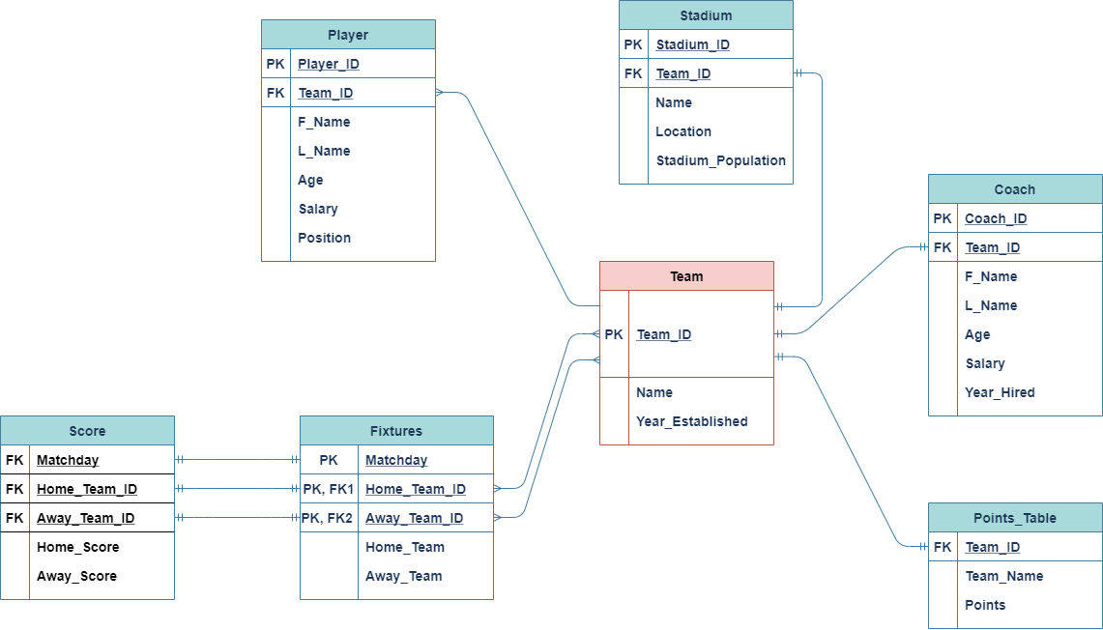

Slide 8
Constraints Applied on Individual Tables

Slide 9
Team Table
Domain Constraints
Team_ID INTEGER PRIMARY KEY
Name VARCHAR(10)
Year_Established INTEGER

Slide 10
Coach Table
Domain Constraints
Coach_ID INTEGER PRIMARY KEY, F_Name VARCHAR(20), L_Name VARCHAR(20), Age INTEGER, Salary NUMERIC(8,0), Year_Hired NUMERIC(4,0), Team_ID INTEGER,
Referential Integrity Constraints
FOREIGN KEY (Team_ID) REFERENCES Team (Team_ID)

Slide 11
Player Table
Domain Constraints
Player_ID INTEGER PRIMARY KEY, F_Name VARCHAR(20), L_Name VARCHAR(20), Age INTEGER, Salary NUMERIC(8,0), Positon VARCHAR(20), Team_ID INTEGER,
Referential Integrity Constraints
FOREIGN KEY (Team_ID) REFERENCES Team (Team_ID)

Slide 12
Stadium Table
Domain Constraints
Stadium_ID INTEGER PRIMARY KEY, Team_ID INTEGER, Name VARCHAR(15), Location VARCHAR(15), Stadium_Population NUMERIC(8,0),
Referential Integrity Constraints
FOREIGN KEY (Team_ID) REFERENCES Team (Team_ID)

Slide 13
Design Of Individual Tables

Slide 14
Teams
Team-ID | Name | Year_Established
1001 | Arsenal | 1885
1002 | Man City | 1890
1003 | Liverpool | 1885
1004 | Man Utd | 1886
Candidate keys – Team_Id, Name
Primary Key – Team_Id
1NF
2NF
3NF
BCNF

Slide 15
Coach
Coach_ID | F_Name | L_Name | Age | Salary | Year_Hired | Team_ID
2001 | Mikel | Arteta | 42 | 300000 | 2019 | 1001
2002 | Pep | Guardiola | 45 | 250000 | 2016 | 1002
2003 | Jurgen | Klopp | 51 | 200000 | 2016 | 1003
2004 | Ole | Solksjaer | 47 | 500000 | 2019 | 1004
Candidate keys - Coach_ID , Team_ID
Primary keys - Coach_ID
1NF
2NF
3NF
BCNF

Slide 16
Player
Player_ID | F_Name | L_Name | Age | Salary | Position | Team_ID
3003 | Hector | Bellerin | 34 | 30000 | Defender | 1001
3005 | Bernd | Leno | 25 | 25000 | Goalkeeper | 1001
3006 | Kevin | Debruyne | 25 | 20000 | Midfielder | 1002
3007 | Bernardo | Silva | 23 | 20000 | Midfielder | 1002
3008 | Alisson | Becker | 26 | 25000 | Goalkeeper | 1003
3015 | Marcus | Rashford | 22 | 35000 | Forward | 1004
3016 | Harry | Maguire | 28 | 35000 | Defender | 1004
Candidate Keys - Player_ID
Primary Keys - Player_ID
1NF
2NF
3NF
BCNF

Slide 17
Stadium
Stadium_ID | Team-ID | Name | Location | Stadium_Population
2001 | 1001 | Emirates | London | 50000
2002 | 1002 | Etihad | Manchester | 65000
2003 | 1003 | Anfield | Liverpool | 65000
2004 | 1004 | Old Trafford | Manchester | 42000
Candidate Keys - Stadium_ID, Team_ID, Name
Primary Keys - Stadium_ID
1NF
2NF
3NF
BCNF

Slide 18
Implementation
In this stage, we create the actual database application by writing SQL Queries in a DBMS software.

